Slide 1
Bank Marketing Campaign Modeling
Yan Xu
Feb 9, 2021

Slide 2
Agenda
Problem Statement and Objectives
Data Overview and Data Cleaning
Exploratory Data Analysis
Current Model Performance
Modeling
Conclusions
Q & A

Slide 3
Problem Statement and Objectives
Problem Statement – To help banking institution determine, in advance, clients who will be receptive to a marketing campaign
Objectives: Finding Data Patterns, Cleaning Data and Evaluate Current Model Performance, and/or Build New Model

Slide 4
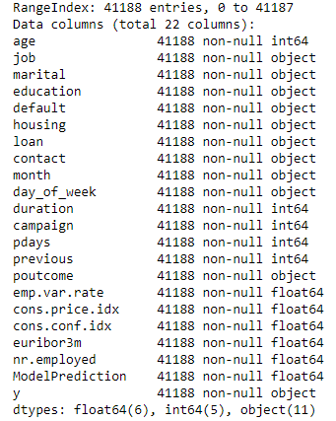
Data Overview and Data Cleaning
Data Structure Overview
Shape of Dataframe: 41188 rows X 22 columns
11 numerical features, 11 categorical features
ModelPrediction(numerical) will only used to evaluate current model performance
Data Cleaning
No Missing Values in all columns of the dataset
There are 12 duplicated rows were removed. The remaining 41176 rows will be used for data analysis

Slide 5
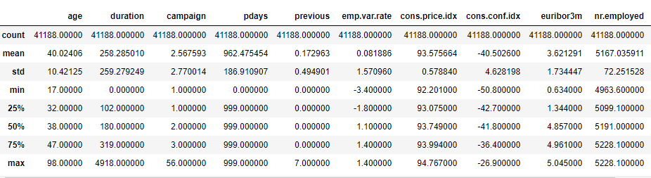
Data Overview and Data Cleaning-Cond
Age: mean=40, median=38, the distribution will be slightly right-skewed
Duration: 4918 may be an outlier, mean = 258, median=180, the distribution will be right-skewed
Campaign: 56 may be an outlier, 75% of the clients were contacted 3 times or less
Pdays: majority of values are 999 which means most clients were not previously contacted
Previous: majority of the values are 0 which means most clients were not contacted before the campaign

Slide 6
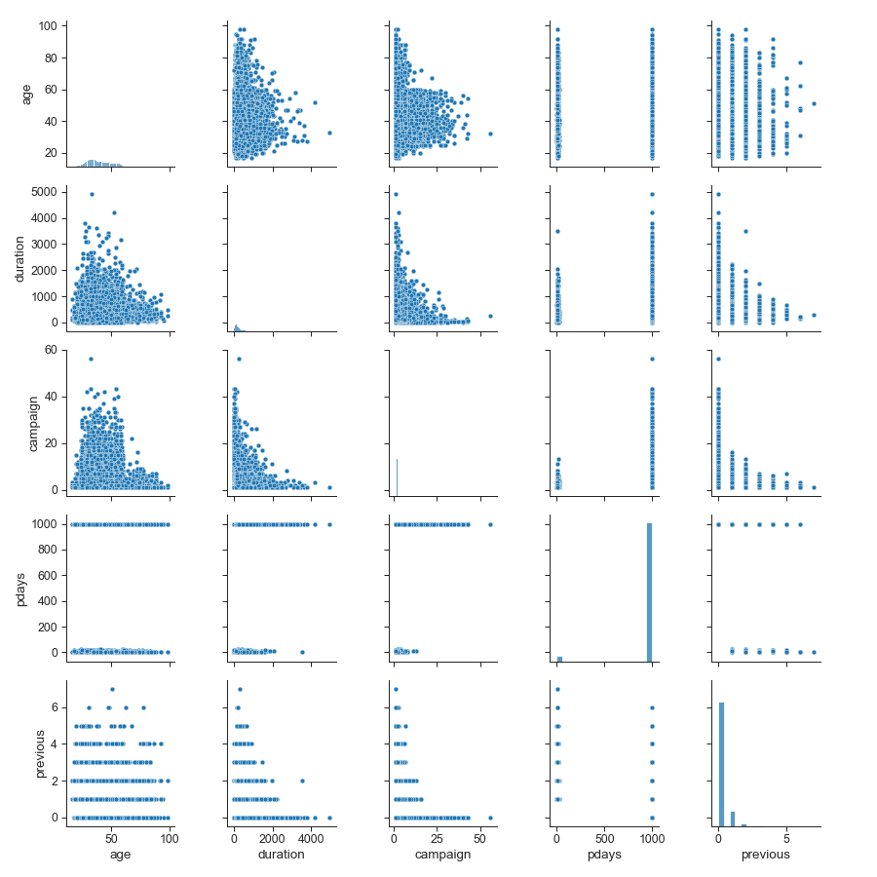
Exploratory Data Analysis-Numerical
First Five Numerical Features: age, duration, campaign, pdays, previous
Pdays has value either around 1000 or around 0
Previous has values only for certain number, 0 is the most popular one
Age and Duration had right-skewed distribution, median is less than mean

Slide 7
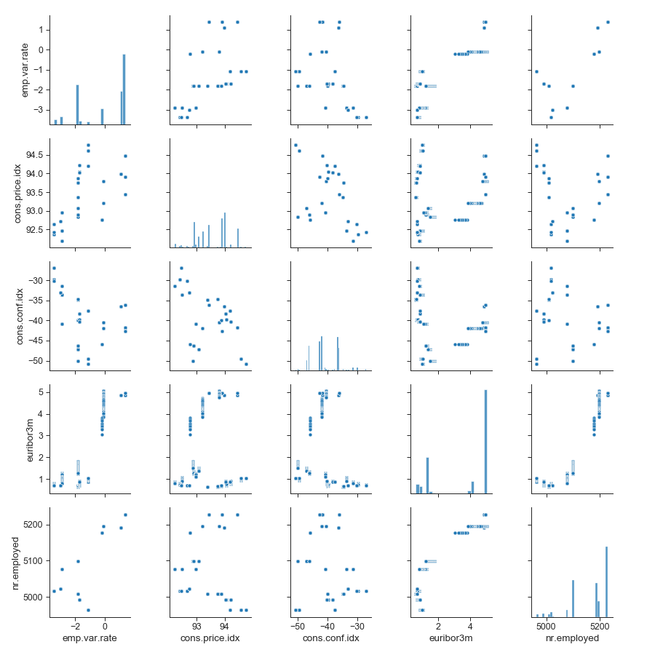
Exploratory Data Analysis-Numerical-Cond
Next Five Numerical Features: emp.var.rate, cons.price.idx, cons.conf.idx, euribor3m, nr.employed
Three of them look like bimodal
Potential Linear correlation features: emp.var.rate & nr.employed, euribor3m & nr.employed
Most of them looks like randomly scattered

Slide 8
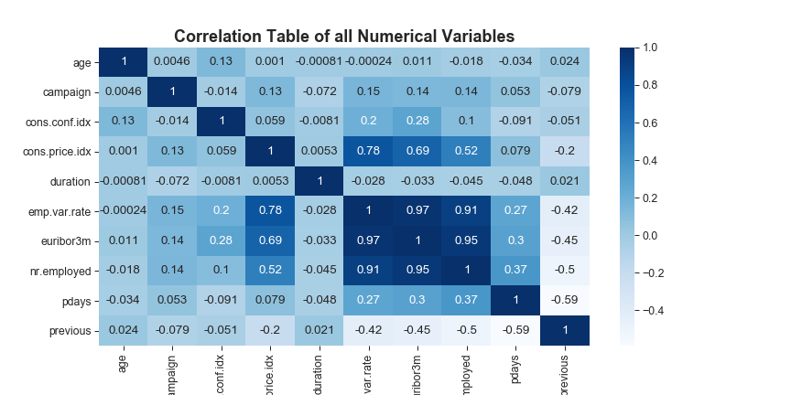
Exploratory Data Analysis-Numerical-Cond
High correlation features: emp.var.rate, euribor3m, nr.employed
Median correlation features: cons.price.idx with three employment status measurements, pdays and previous
Multicollinearity issue
Two ways to mitigate: 1. remove highly correlated features. 2. Principal Component Analysis

Slide 9
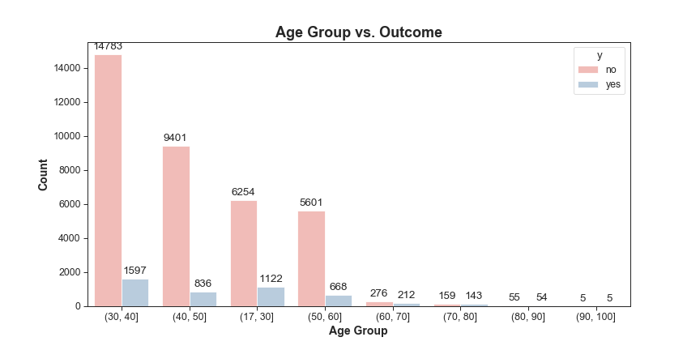
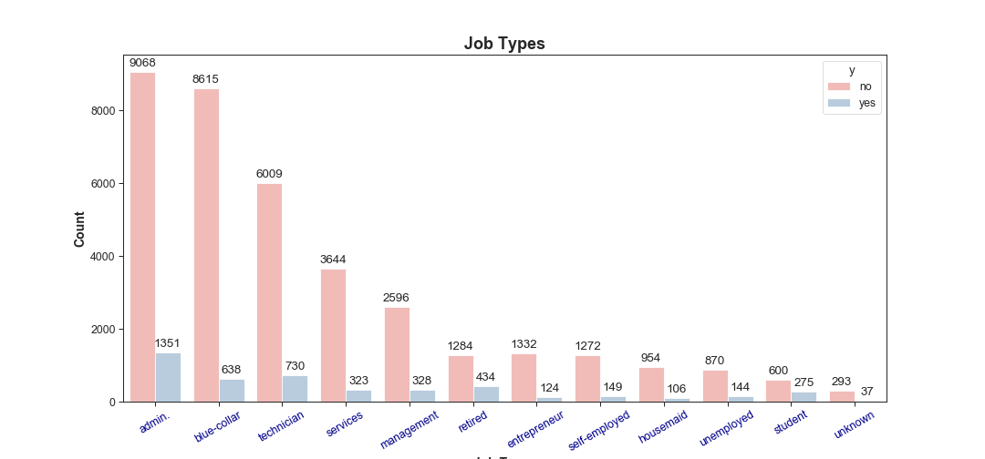
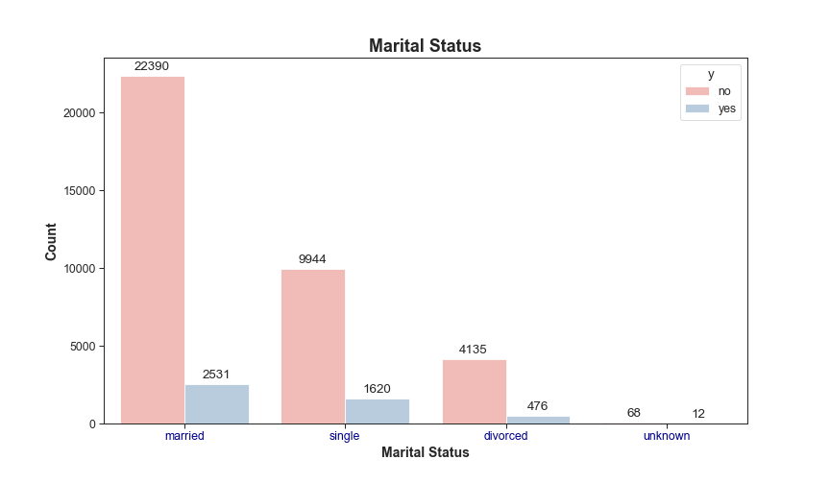
Exploratory Data Analysis-Categorical
Age Group: 30-40 and 17-30
Job Types: admin and technician
Marital Status: both married and single persons

Slide 10
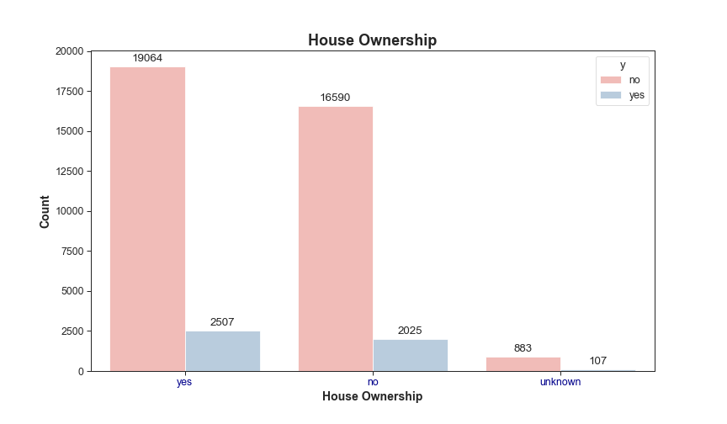
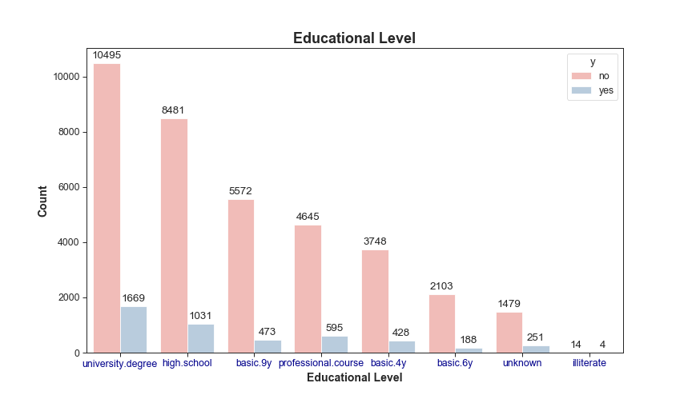
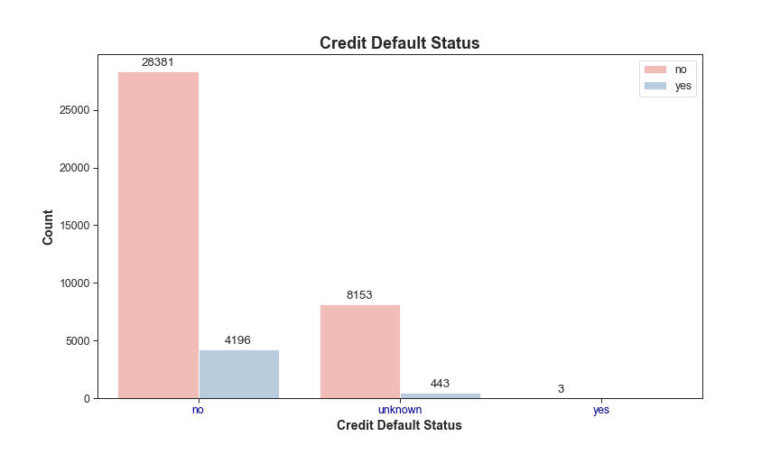
Exploratory Data Analysis-Categorical Con’d
Educational Level: an university degree or high school graduate
House Ownership: people who own a house
Credit Default Status: no credit in default

Slide 11
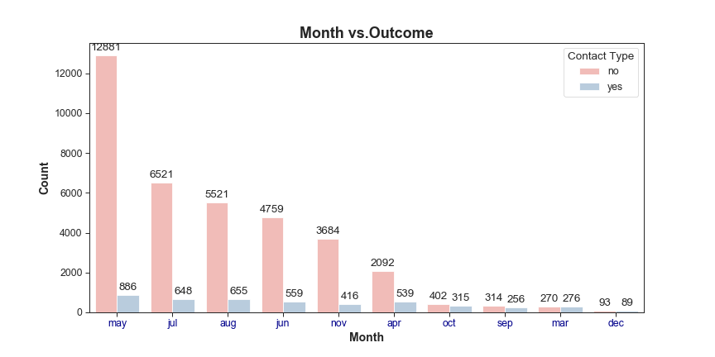
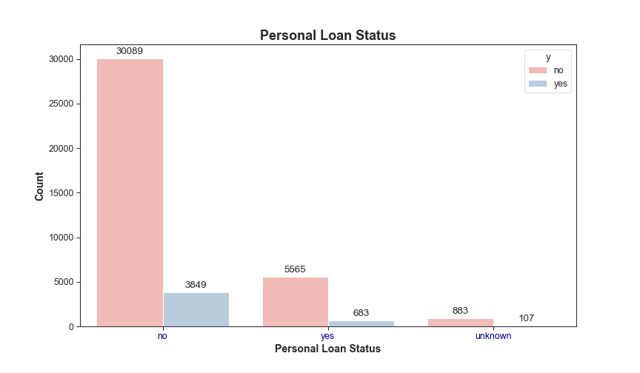
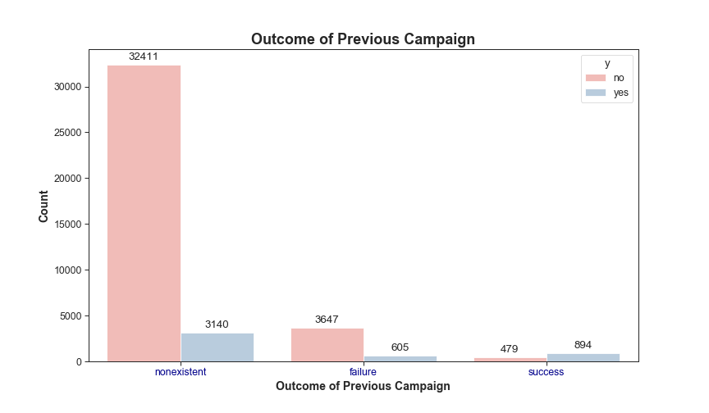
Exploratory Data Analysis-Categorical Con’d
Month: May, July and August
Personal Loan Status: no personal loan
Outcome of Previous Campaign: not in previous marketing campaign

Slide 12
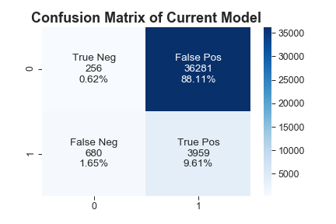
Current Model Performance
The actual result of current campaign: yes: 4,639(11%), no: 36,537(89%)
The overall accuracy score of the current model is: 0.11
88% of the model predicted results are False Positive.
1.65% of the model predicted results are False Negative.
Improve the overall accuracy score, reduce False positive

Slide 13
Modeling-Data Pre-processing
Due to potential multicollinearity issue, features emp.var.rate and euribor3m will be excluded from the model. Both of them had the strong correlation coefficient with other features
Take out unnecessary columns- ModelPrediction(current model results), duration(big impact on model results), and agegrp1(created feature)
Convert ‘pdays’ and ‘contact’ into binary (0 or 1)
Separate ‘y’ column from the remaining columns, the remaining columns will be the input features to the model
Perform one-hot encoding to convert categorical features into numerical
Split both input and ‘y’ into training and testing dataset with a 30% Test and 70% Train split ratio

Slide 14
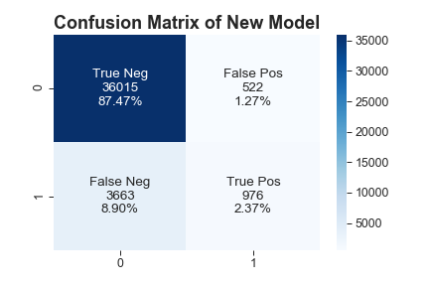
Modeling-Logistic Regression
Overall accuracy score of the new model is: 0.89
1.27% of the predicted results are False Positive. Reduced from current model(88%)
87% of the model predicted results are True Negative. Saving resource on unnecessary contact
8.9% are False Negative. This will be the lost revenue opportunities.

Slide 15
Conclusions
Ideal clients persona
Age between 17-40
Professionally work either as an admin or technician
Could be married or single
Have a university degree or high school diploma
Own a house, is not in credit default and do not have personal loan
Summer time(May, July, August) are the best time to contact clients
Current Model Performance
Overall accuracy ~ 11%
Good True Positive percent; Non-ideal False Positive percent(88%)
Potential extra cost of contacting large amount of False Positive clients
New Model Performance
Overall accuracy ~89%
Reduced False Positive from 88% to 1.27%; Increased False Negative from 1.65% to 8.9%
Potential revenue lost for not contacting False Negative clients
Future Improvement
Hyperparameter Tuning
PCA

Slide 16
Q & A

Slide 17
Thank You

Slide 18
Backup 1. Monetize the Confusion Matrix
Assume the cost of contacting each potential client is $20, the revenue can be generated from each client that has been successfully subscribed is $100 per client
Current Model: Cost = (36,281+3,959) x $20 = $ 804,800, Revenue= 3959 x $100= $395,900. Potential client’s revenue ( a cost to bank)=680x$100 = $68,000. Overall, $395,900 – $804,800 - $68,000=$ -476,900
New Model: Cost = (976+522) x $20 = $29,960, Revenue=976x$100= $97,600, Potential Client’s revenue( a cost to bank) = 3,663 x $100 = $366,300. Overall, $97,600 - $29,960 - $366,300 = $-298,660

Slide 19
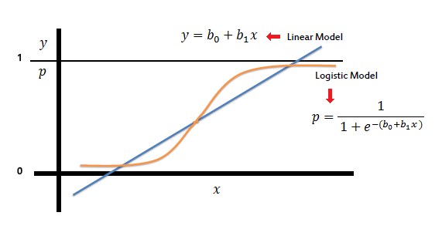
Backup 2. Logistic Regression
A go-to method for binary classification problems
Logistic Regression is a linear method
The output is a probability (of success or failure) that depends on continuous inputs

Slide 20
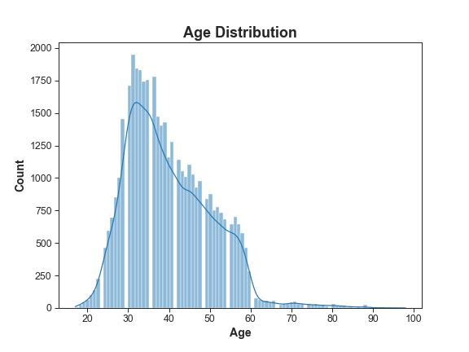
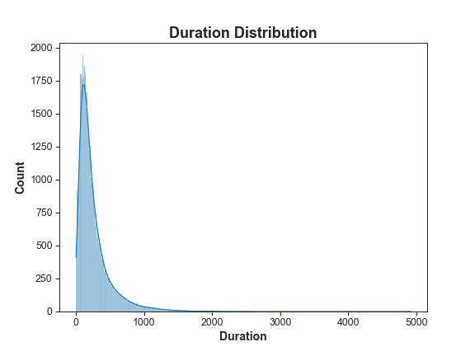
Backup 3. Age and Duration Distribution
Age Distribution: slightly right-skewed
Duration Distribution: right-skewed

